Slide 1


Assistant Prof. Luay A. Naeem

Slide 2
Digestive System
The digestive system consists of the parts of the body involved in chewing and digesting feed. This system also moves the digested feed through the animal’s body and absorbs the products of digestion.
Digestion: is the process of breaking down feed into simple substances that can be absorbed by the body.
Absorption: is the taking of the digested parts of the feed into the bloodstream.

Slide 3
Digestive System
Different species of animals are better able to digest certain types of feeds than others. This difference occurs because of the various types of digestive systems found in animals.
There are four basic types of digestive systems in animals are monogastric, avian, ruminant, and pseudo-ruminant.

Slide 4
Continue…………….
Monogastric animals, such as hogs, cats, dogs, and humans.
The ruminant digestive system is found in cattle, sheep, goats, and deer.
The pseudo-ruminants are found in horse, rabbits, guinea pigs, and hamsters.
The avian digestive system, found in poultry, is completely different from the other three types of digestive systems.

Slide 5
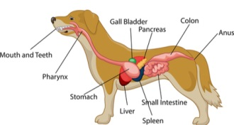
Digestive system

Slide 6
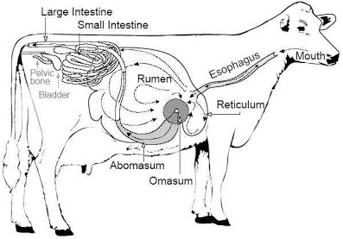
Ruminant digestive system

Slide 7
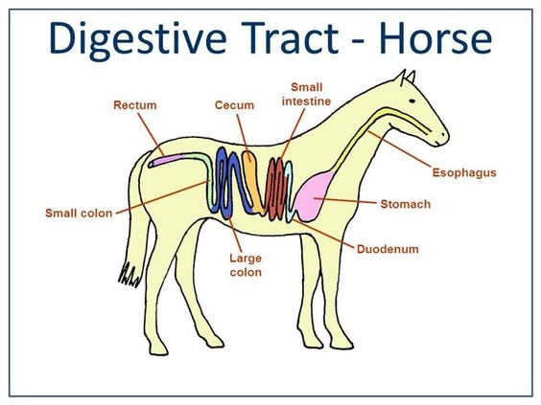

Slide 8
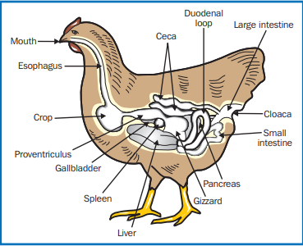

Slide 9
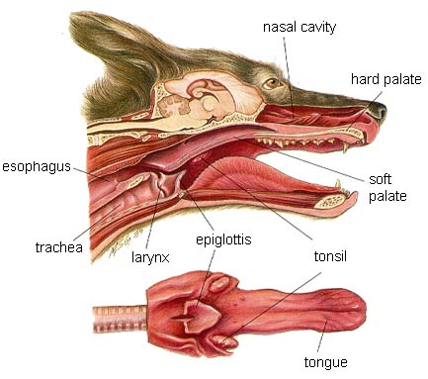
MOUTH

Slide 10
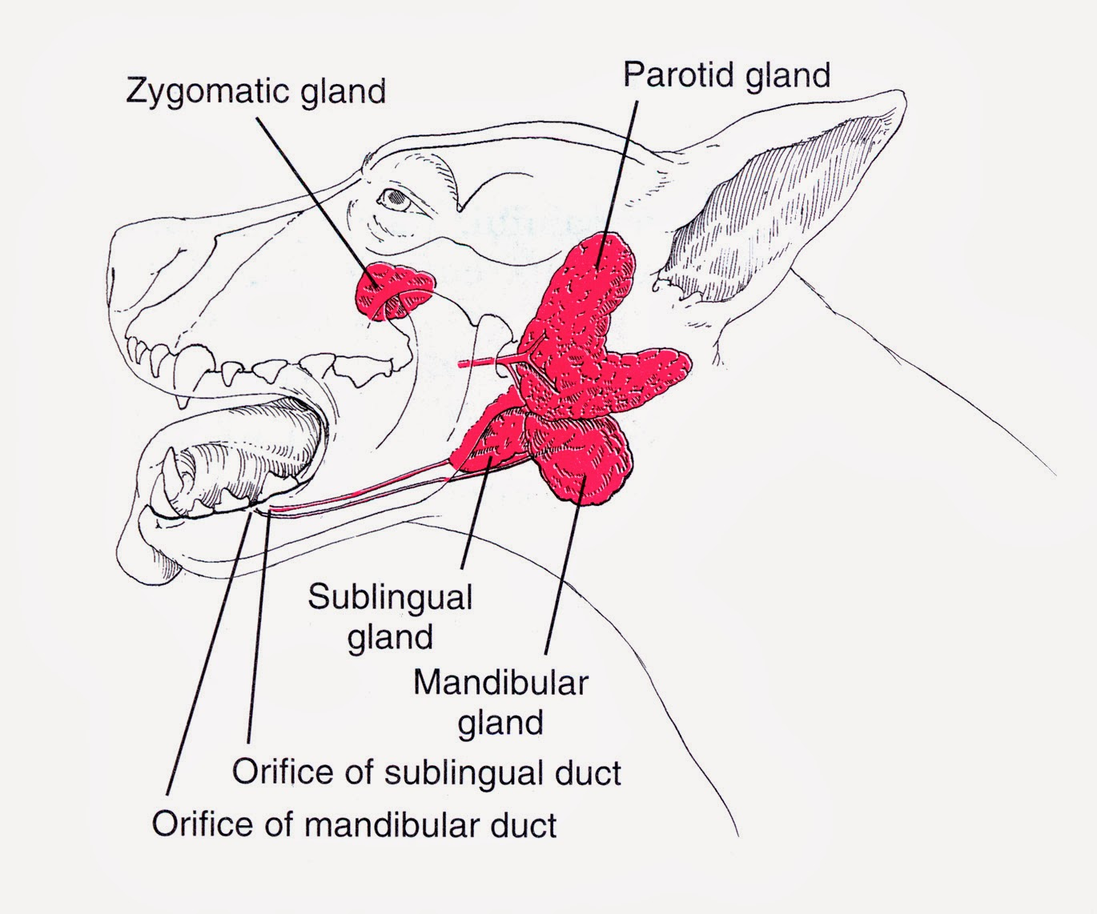
Salivary Glands

Slide 11
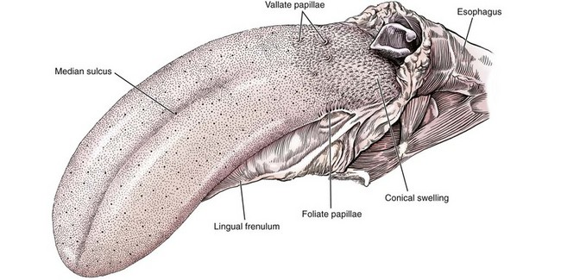
TONGUE

Slide 12
Anatomy
The tongue consists of a root, which anchors it to the oropharynx; a body, which extends rostral to the root and is attached to the floor of the oral cavity via the frenulum; and the apex, which is rostral and unattached to the frenulum. Adjacent to each side of the frenulum is a raised area of mucosa running longitudinally called the sublingual fold. This fold courses rostrally, ending at the sublingual caruncle.

Slide 13
The root of the tongue:- consists of a set of three paired extrinsic muscles:
1- Styloglossus muscles \ They draw the tongue caudally.
2- Hyoglossus muscle \ It acts to retract and depress the tongue.
3- Genioglossus muscle\ It acts to depress and protrude the tongue.

Slide 14
The intrinsic muscles of the tongue are complex and often course into one another with no discernible borders, the muscles are categorized into units of fibers:
1- Superficial longitudinal.
2- Deep longitudinal.
3- Transverse, and
4- Perpendicular.
*The intrinsic muscles are responsible for protruding the tongue and a variety of other intricate movements in combination with the extrinsic lingual muscles

Slide 15
Styloglossus
Genioglossus
Hyoglossus

Slide 16
Physiology
The tongue is the most versatile organ in the oral cavity. It is responsible for food prehension, water lapping, sucking, mastication, tasting, swallowing, grooming, thermoregulation, and vocalization. Most of these functions require precise motor control, which is why the tongue consists almost entirely of skeletal muscle.

Slide 17
Blood Supply and Innervation
*The lingual artery is a branch of the internal carotid artery and is the principle source of blood to the tongue.
*The lingual vein starts at the apex of the tongue, courses alongside the lingual artery, and eventually empties into the facial vein.

Slide 18
Nerve supply
* All pairs of extrinsic and intrinsic muscles are under control of the hypoglossal nerves (cranial nerve No 12).

Slide 19
Cranial Nerves
In higher vertebrates (reptiles, birds, mammals) there are 12 pairs of cranial nerves:
1- Olfactory (CN I),
2- Optic (CN II),
3- Oculo-motor (CN III),
4- Trochlear (CN IV),
5- Trigeminal (CN V),
6- Abducent (CN VI),
7- Facial (CN VII),
8- Vestibulo-cochlear (CN VIII),
9- Glossopharyngeal (CN IX),
10- Vagus (CN X),
11- Accessory (CN XI), And
12- Hypoglossal

Slide 20
DISORDERS OF THE TONGUE
1- Congenital Disorders.
2- Infectious Disorders.
3- Acquired Disorders.

Slide 21
1- Congenital Disorders
Tongue malformations such as macroglossia and microglossia, are rare in dogs and cats.
Ankyloglossia is a congenital disorder in which the lingual frenulum is abnormally short and thickened, restricting movement. Affected dogs have difficulty suckling, licking, swallowing, and vocalizing, resulting in stunted growth, ptyalism, and difficulty eating.

Slide 22
Ankyloglossia
Is a congenital anomaly of oral cavity which is otherwise termed as tongue tie.
It is characterized by an abnormally short lingual frenulum resulting in decreased mobility of tongue, This condition can be treated by frenulotomy or frenuloplsaty, dogs were able to eat normally immediately after surgery.

Slide 23
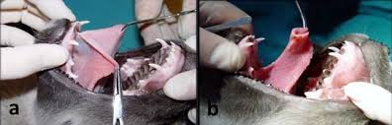
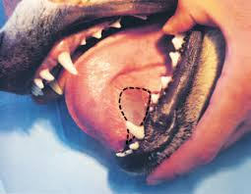

Slide 24
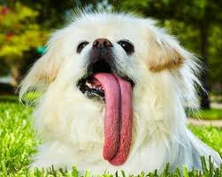
Macroglossia: Enlargement of the tongue but not indicating the cause, the association with malocclusion. It has been reported that resection of as much as 60% of the body of the tongue is well tolerated by dogs. Although the tongue is a very vascular organ, intraoperative hemorrhage during tongue amputation can be effectively controlled by a tourniquet at the base of the tongue. Healing of the amputation wound is usually rapid and uneventful.

Slide 25
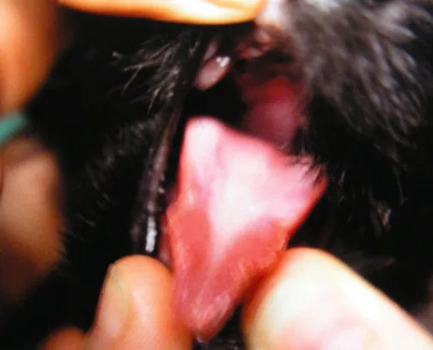
Microglossia: is a congenital defect characterized by missing or underdeveloped lateral and rostral thin portions of the tongue that result in prehensile and motility disturbances

Slide 26
2- Infectious Disorders:
A- Lingual abscesses: in dogs result from penetrating injury through the oral mucosa.
The most common site of penetrating oral injury is directly underneath the tongue (sublingual).
Presenting clinical signs usually consist of
1- lethargy,
2- ptyalism, and
3- anorexia.
*In dogs The tongue is a rare site for infection, probably because of its rich blood supply, ability to avoid penetrating injury, tough dorsal surface, and continual contact with saliva, which has antibacterial properties,

Slide 27
Continue…………….
Treatment consists of
1- passive or
2- active drainage.
3-Marsupialization of the abscess into the oral cavity after surgical drainage may help prevent reformation of the abscess and provides a route for drainage.
For large abscesses, placement of Penrose drains exiting the more dependent ventral cervical region may be warranted.

Slide 28
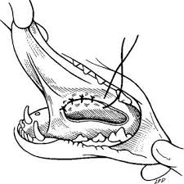
Marsupialization

Slide 29
In cattle's the wooden tongue is common infectious disorder of tongue.
Wooden Tongue (Actinobacillosis): is a well-defined disease of the soft tissues of the mouth region in adult cattle. It is caused by Actinobacillus lignieresii, part of the normal bacterial flora of the upper digestive tract. The bacteria usually invade the skin through a wound or minor trauma caused by sticks, cereal awns or similar.

Slide 30
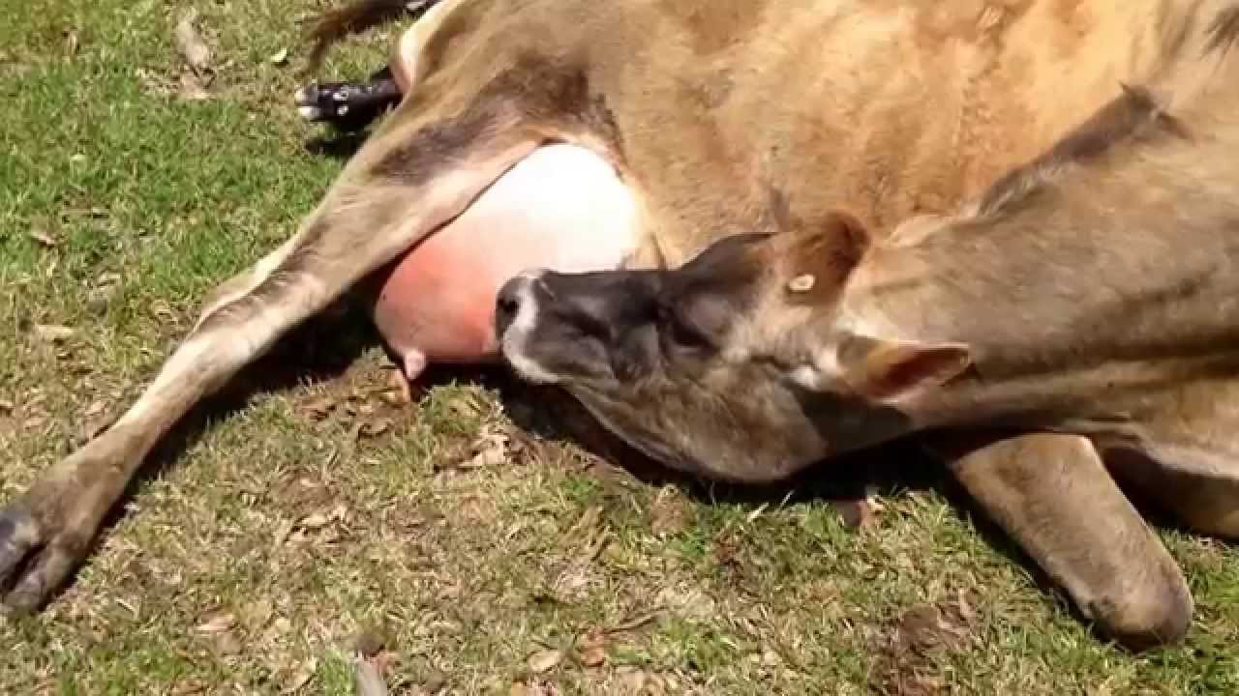

Slide 31
DISORDERS OF THE TONGUE
3- Acquired Disorders:
A- Self-Suckling
Self-suckling is most commonly treated by using a nasal ring with a burr or nasal flap and individual housing. If these more conservative treatments are not successful, a partial glossectomy can be considered.

Slide 32
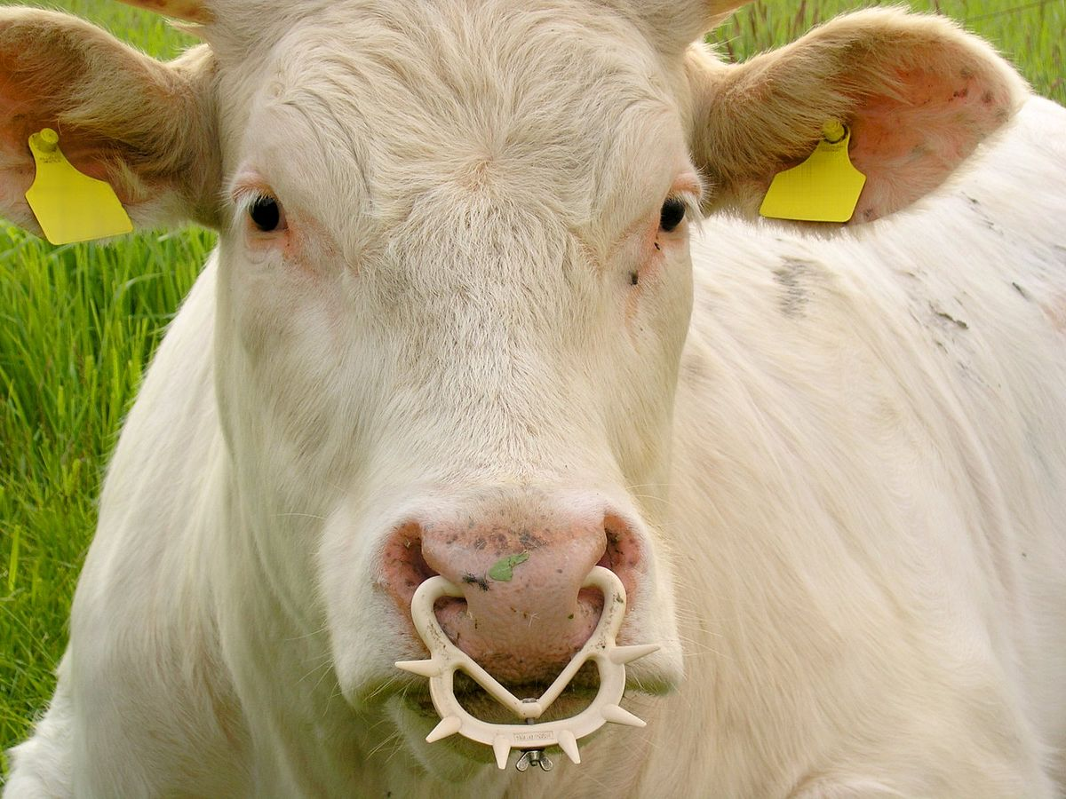
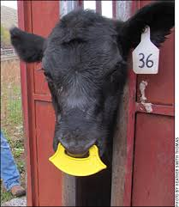
Nasal Flap
Nasal Ring with a Burr

Slide 33
glossectomy
glossectomy is the surgical removal of all or part of the tongue. It is performed in order to curtail malignant growth such as oral cancer. Often only a portion of the tongue needs to be removed, there are three type of glossectomy
Partial glossectomy—removal of part of the tongue
Hemiglossectomy—one side of the tongue is removed
Total glossectomy—removal of the whole tongue

Slide 34
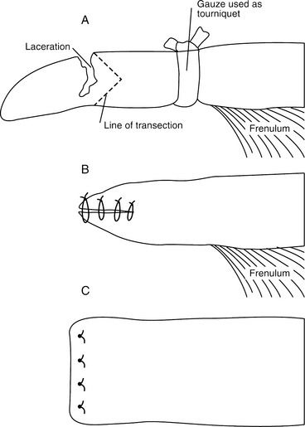
Glossectomy

Slide 35
Continue………………
B- Neoplasia and Hyperplastic Lesions:
Tumors of the tongue make up a small percentage (3% to 4%) of all oropharyngeal tumors in the dog. Malignant melanoma and squamous cell carcinoma are the most common lingual tumors followed by squamous papilloma, plasmacytoma, and fibrosarcoma.
The majority of dogs with lingual neoplasms are asymptomatic, with masses noted by the owner or detected as incidental findings on physical examination.

Slide 36
Continue………………
The prognosis for lingual neoplasia is based on histopathologic diagnosis, tumor grade, tumor size, and clinical stage, although the location of the tumor has been suggested to affect prognosis, the partial glossectomy if don’t have metastasis is preferable choice.

Slide 38
Squamous cell carcinoma of the tongue in a 10-year-old German shepherd dog After glossectomy using electrosurgery

Slide 39
C- Trauma
Penetrating trauma to the mouth from foreign objects is sometimes seen in dogs, injury secondary to tongue entrapment, resulting in multiple lacerations and traumatic amputation of the entire tongue body; piranha bite and entrapment of the tongue in a cage grate and a chain-link fence.
Burns from electrical cords are sometimes seen in
young dogs and cats and often involve the hard palate and gingiva.
Lacerations should be debrided and lavaged; most
can be closed primarily by suturing.

Slide 40
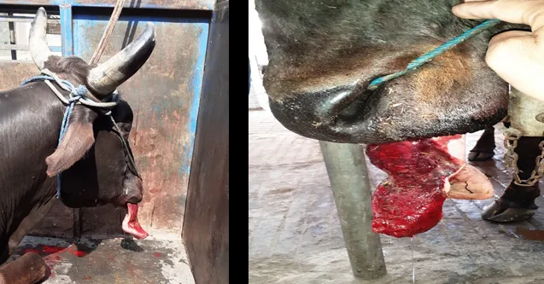
Protruded tongue with lacerated trauma

Slide 41
Quiz
and
Rest

Slide 42
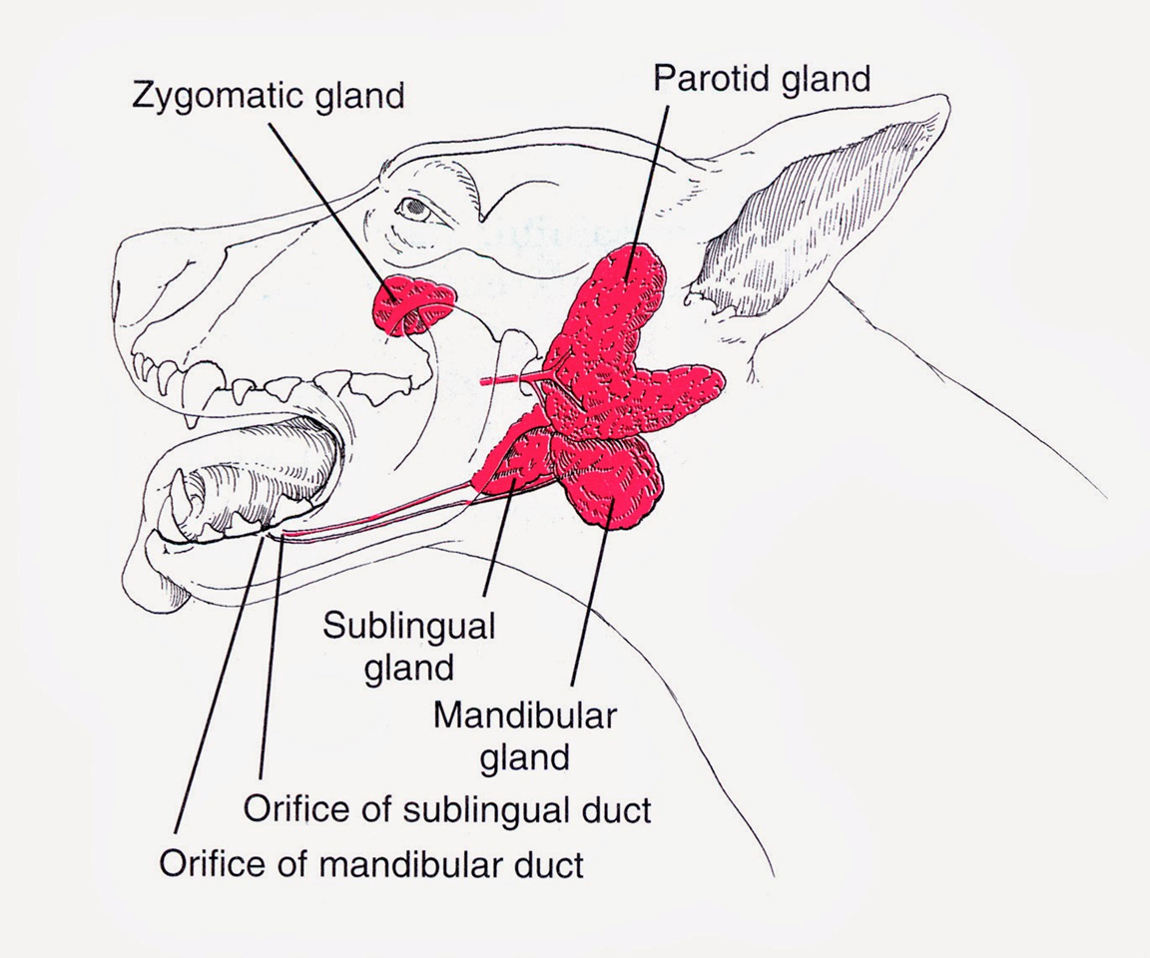
Salivary Glands Affections

Slide 43
Anatomy of salivary glands
*The salivary glands in dogs and cats are categorized as major or minor, depending on their size, location and the contribution of saliva.
*The four major pairs of salivary glands in dogs and cats are
1- Parotid,
2- Mandibular,
3- Sublingual, and
4- Zygomatic.

Slide 44
The minor salivary glands are named by their location, typically small collections of salivary tissue surrounding the oral cavity that drain their secretions directly into the oral cavity to keep it moist, These glands includes
1- Buccal,
2- Labial,
3- Lingual,
4- Tonsillar,
5- Palatine, and
6- Molar.

Slide 45
PHYSIOLOGY
*Salivary glands in dogs and cats produce saliva (serous, mucus) that primarily functions to lubricate ingesta and facilitate packaging of a food bolus for its passage down the esophagus.
*Other functions of saliva include thermoregulation (evaporative cooling), oral cavity cleansing, buffering of weak acids, reduction of oral bacterial growth, and protection of surface epithelium in the oral cavity

Slide 46
Advantages of Saliva
1-Keep the mouth moist.
2-Wet & lubricate food materials.
3-Dissolved some elements of food.
4-Enables of appreciation of taste.
5-It initiates digestion of starchy food.

Slide 47
Salivary Glands Affections
1- Nonsurgical salivary gland disease
A- Sialadenosis: is a noninflammatory swelling of the salivary glands, most commonly affecting the mandibular salivary glands, the cause is unknown.
Clinical signs in dogs include:
Retching, gulping, lip smacking, hypersalivation, and weight loss.
Affected glands are enlarged but are usually nonpainful, histologically, affected glands show minimal to no changes in shape.

Slide 48
Continue…………….
B- Sialadenitis and Necrotizing Sialometaplasia:
Salivary glands can develop inflammation (sialadenitis) that occasionally progresses to glandular necrosis and ductal metaplasia. Sialadenitis and necrotizing sialometaplasia have clinical signs very similar to sialadenosis, with the addition of pain upon palpation of the affected glands and vomiting.

Slide 49
Continue……………..
2- Surgical Salivary Gland Disease:
A-Sialoceles:
also termed salivary mucoceles, are collections of saliva within subcutaneous tissue. Resultant saliva-filled cavities are lined by inflammatory connective tissue and are not true cysts. The most common source of saliva is leakage from the sublingual salivary gland or duct, but origination from any gland is possible.

Slide 50
Etiology of Salivary Mucocele:-
1-Trauma.
2-Foreign bodies.
3-Sialoliths, and
4- Neoplasia;

Slide 51
Continue……………
The location of the sialocele often determines the presenting complaint and indicates the offending gland. The four main presentations are:
1-Zygomatic Sialoceles (Exophthalmoses).
2-Pharyngeal Sialoceles (Labored breathing).
3-Sublingual Sialoceles (Dysphagia).
4-Cervical Sialocele (Intermandibular or Cranioventral Cervical Swelling).
*The sublingual salivary gland is the most commonly involved.

Slide 52
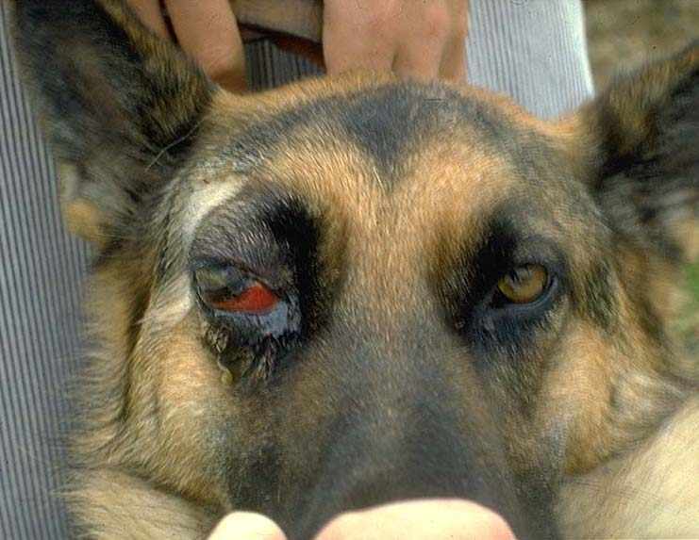
Zygomatic Sialoceles
Pharyngeal Sialoceles

Slide 53
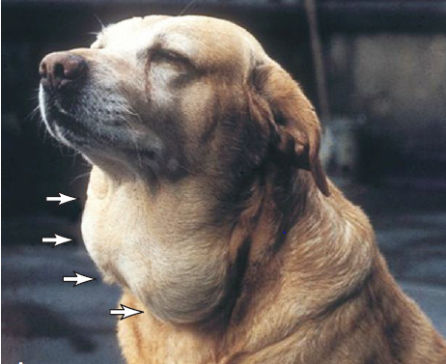
Cervical Sialocele
Sublingual Sialoceles

Slide 54
Signs of Salivary Mucocele
1-Saliva commonly accumulation in the cranial cervical or inter-mandibular area, sublingual, or pharyngeal tissues.
2-Saliva irritates the tissue & cause inflammation.
3-During this initial phase the swelling may be firm & painful, but the animals is asymptomatic.
4-Granulation tissue forms in response to the inflammation & prevents saliva from migrating.

Slide 55
Diagnosis of Salivary Mucocele
1-From clinical sings & pathological finding.
2-Radiographs (Sialograph) may determine which gland is involved.
3-Histopathologic examination.

Slide 56
Treatment of Salivary Mucocele
A- Medical treatment
Repeated drainage or injection of cauterizing or anti-inflammatory agents does not eliminate mucocele; however, it complicates subsequent surgery by leading to abscessation or fibrosis

Slide 57
B- Surgical treatment
-Sublingual and Mandibular Sialadenectomy
Sublingual and mandibular sialadenectomy is one of the most common surgical procedures performed on the salivary glands because most sialoceles originate from this duct–gland complex. Although most cervical sialoceles originate from the sublingual gland, the mandibular gland is removed as well because of its intimate anatomic association with the sublingual gland. Several approaches have been reported; however, we prefer a ventral approach to facilitate removal of the most rostral portions of the sublingual gland.

Slide 58
Notes:
The black line indicates the outline of the mandible and the blue line demonstrates the position of the incision to perform the ventral approach to the mandibular and sublingual salivary glands (A). This incision can be made midline if bilateral sialadenectomy is to be performed. Notice the mandibular (M) salivary gland at the caudal aspect of the incision (B).

Slide 59
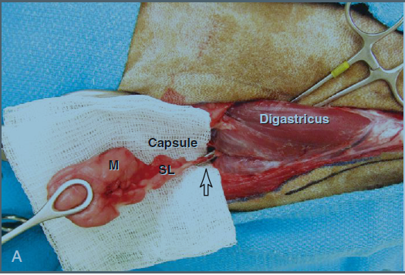
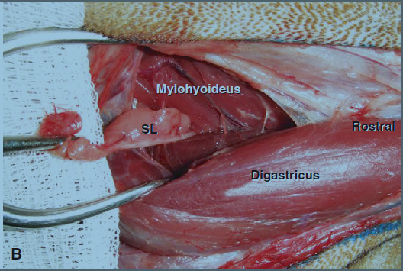
Once the salivary tissue has been freed from its surrounding tissue, a hemostat can be placed from rostral to caudal under the digastricus muscle to clamp the duct–gland complex
Caudal traction of the mandibular (M) and sublingual (SL) salivary gland facilitates dissection of the ducts and glands under the digastricus muscle.

Slide 60
B- Salivary Gland Neoplasia
Primary salivary gland neoplasia of the major and minor glands is uncommon in dogs and cats, with a reported incidence of 0.17%. The mandibular and parotid salivary glands are most commonly affected. Tumor invasion into local tissues and spread to regional lymph nodes occasionally occur.
Animals with salivary gland tumors present with a variety of clinical signs, including a unilateral, nonpainful, firm swelling in the region of the upper neck, base of the ear, and upper muzzle or maxilla; halitosis; exophthalmos; and dysphagia

Slide 61
Diagnostic evaluation of these animals should include sampling of the mass and regional lymph nodes (needle or incisional biopsy) and three-view thoracic radiographs for metastases. Blood work and abdominal ultrasonography should be performed if clinically indicated. CT and MRI can be extremely valuable with preoperative surgical planning of locally invasive disease.

Slide 62
C- Sialoliths:
Historically, affected animals usually have a swelling on the lateral aspect of the face that may be painful and may regress and then reoccur.
Sialoliths are most often associated with the parotid duct but have also been reported in the mandibular–sublingual duct complex
Stone compositions may include calcium, oxalate, phosphate, magnesium, carbonate, ammonium, or nonmineral proteinaceous material.

Slide 63
Diagnosis of a salivary sialolith can occasionally be made by palpation or on radiographs; however, CT usually provides more specific information.
Sialoliths can be treated by several strategies, including gland and duct removal, duct resection and anastomosis, marsupialization of the dilated duct into the oral cavity, and incision over the stone for removal with primary duct repair.
*Determination of optimal treatment depends on the location of the sialolith, presence of infection, ease of duct and gland removal.

Slide 64
Treatment of Sialoliths
The affected duct– gland complex can be surgically removed along with the sialolith if the sialolith originates from an easily removable complex such as the mandibular and sublingual salivary gland. If the sialolith is close to the papilla or palpable within the oral cavity, an incision can be made through the mucosa directly over the stone. The incision is left to heal by second intention.
Sialoliths have also been successfully treated by complete ligation of the duct, resection and anastomosis, and primary repair of the affected duct. If duct dilatation is the primary clinical sign, marsupialization of the duct into the oral cavity has been reported as a successful option.

Slide 65
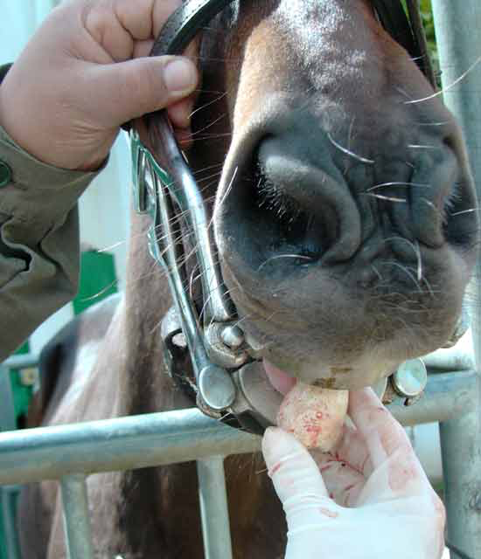
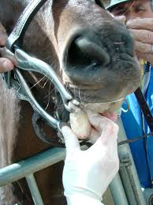

Slide 66
THANK YOU

